Slide 1

Fundamentals – recap

Slide 2


Java: First few concepts – recap
Package – used to give a type a unique name
package qa.training;
public class Student {
Trainter trainer;
}
package qa.training;
public class Trainer {
Student student;
}
Classes in the same namespace can refer to classes
package sales;
import qa.training.*;
public class Program {
public static void main( String[] args) {
Student student;
Classes in the a different package

Slide 3
C#: First few concepts – recap
namespaces – used to give a type a unique name
namespace qa.training {
public class Student {
Trainter trainer;
}
}
namespace qa.training {
public class Trainer {
Student student;
}
}
Classes in the same namespace can refer to classes
import qa.training;
namespace sales {
public class Program {
public static void main( string[] args) {
Student student;
}
}
}
Classes in the a different namespace

Slide 4
First few concepts – recap
Eight primitive types supplied as value-types byte, char, short, int,long,float, double, boolean
Compound operators +=, -=, *=, /=, %=
int x = 4, y = 6;
x = x + y;
x += y;
int x = 5;
x = x + 1;
x++;
++x;
X = 8
X = 10
X = 16
int x = 5;
x = x -1;
x--;
--x;
X = 5

Slide 5
Pre and post increment / decrement
int x = 4, y = 6;
x = y++;
X = 6
Y = 7
int x = 4, y = 6;
x = ++y;
X = 7
Y = 7

Slide 6
Methods and parameter passing
public class HR {
public boolean register(String name, int age, String courseName) {
return true;
}
}
public class Student {
private String name;
int age;
public void attendCourse() {
HR hr = new HR();
boolean success = hr.register(name,age,"Java");
}
}
C#: string and bool

Slide 7
Methods and parameter passing
public class HR {
public boolean register(String name, int age, String courseName) {
return true;
}
public boolean register(Student student, String courseName) {
return true;
}
}
public class Student {
private String name;
int age;
public void attendCourse() {
HR hr = new HR();
boolean success = hr.register(this,"Java");
}
}

Slide 8
Formatted output via System,out.printf()
System.out.println("Name: %s, Age: %d", name, age);
Java:
C#
String result = String.format("Name: %s, Age: %d", name, age);
System.out.println(result);
string result = string.Format("Name: {0}, Age: {1}", name, age);
Console.WriteLine(result);
Console.WriteLine("Name: {0}, Age: {1}", name, age);
result = string.Format($"Name: {name}, Age: {age}");
Console.WriteLine(result);
Console.WriteLine($"Name: {name}, Age: {age}");

Slide 9
Conditionals and operators
if(age > 16) {
}
if(age > 16) {
}
else {
}
if (age < 16 || age > 18) {
}
if (age > 16 && age < 18) {
}
switch (age) {
case 15:
// do something
break;
case 16:
case 17:
// do something
break;
default:
// do something
break;
}

Slide 10
Reading data in from console
There is no System.in.readln(). Use java.util.Scanner
C#
Scanner s = new Scanner(System.in);
System.out.println("What is your name?");
String name = s.nextLine();
System.out.println("What is your age?");
int age = s.nextInt();
Console.Write("What is your name?");
string name = Console.ReadLine();
Console.Write("What is your age?");
int age = int.Parse(Console.ReadLine());
Notes:
Use the (java.util).Scanner class, you can create one pointing at your console known as System.in and then use a wealth of methods like nextLine() nextInt() nextDouble() to retrieve typed input.
Remember how we can produce a meaningful display by concatenating literals like “Hi “ and “nextyear you will be” with variables like ‘name’ and an expression like (age + 1).
This enables output of:
“Hi Fred, nextyear you will be 21” – when the user types “Fred” to the first prompt and 20 to the second.

Slide 11
Arrays – simplest sort of collection
int[] votes; // declare
votes = new int[3]; // create
String[] names = new String[6]; // declare & create
int[] numbers = {4,3,8,12}; // declare & create & fill
names[0] = "Bob";
votes[0] = 80;

Slide 12
Arrays
int[] numbers = {4, 3, 8, 12, 45, 5};
int len = numbers.length;
int i = 0;
while (i < len) {
print(numbers[i++]);
}
int len = numbers.Length;
int i = 0;
while (i < len) {
print(numbers[i++]);
}
for (int i=0; i<numbers.length; i++) print(numbers[i]);
for (int i = 0; i < numbers.Length; i++)
print(numbers[i]);
for (int x : numbers)
print(x);
foreach (var no in numbers)
print(no)
Java
C#
Notes:
C#. The syntax is the same except arrays have a L:ength property not length (lowercase letter L)

Slide 13
Defining your own types
public enum Status{
Active,
Completed,
Left
}
public class Student {
private String name, course;
private int age;
private Status status;
public Status getStatus() {
return status;
}
public void setStatus(Status status) {
this.status = status;
}
// other getters and setters
}
Student stu = new Student();
stu.setStatus(Status.Active);
stu.setName("Bob");
stu.setAge(25);
// Set other fields

Slide 14
Defining your own types - Constructors
public class Student {
private String name, course;
private int age;
private Status status;
public Student(String name, int age, String courser, Status status) {
this.name = name;
this.age = age;
this.course = course;
this.setStatus(status);
}
// the other getters and setters
}
ξ
Student stu = new Student();
⎭
Student stu = new Student("Bob",25,"Java",Status.Active);

Slide 15
String Class
Strings are immutable; no methods to change their state
Methods like trim(),toUpperCase() etc. all return new String ref
In Java, are NOT enumerable without invoking toCharArray()
String name = “Fred”; char c = name.charAt(2);
char c = name[2]; <- C#
for (char c : name.toCharArray()) { ...
foreach (char c in name) <- C#
...

Slide 16
Strings are immutable
"Bob"
name = "Bob";
name
☒
name[0] ='R';
name = name + "by";
"Bobby"
public static void main(String[] args) {
String name = "Bob";
changeName(name);
}
private static void changeName(String name) {
name = "Bobby";
}
"Bob"
name
"Bobby"
name

Slide 17
StringBuilder
StringBuilder is a mutable String buffer
Key methods: append(), insert(), replace(), delete()
"Bob"
"Bobby"
StringBuilder sb = new StringBuilder("Bob");
sb.append("by");
sb
String name = sb.toString();

Slide 18
Generic (Collection) classes – ‘type’ parameter(s)
ArrayList<E>, ArrayDeque<E>, TreeMap<K,V>
C#: List<T>, Queue<T>, Disctionary<k,v>
ArrayList<String> names = new ArrayList<String>();
names.add("Bob");
names.add("Linda");
print(names.get(0));
for (String x : names)
System.out.println(x);
Java
List<string> names = new List<string>();
names.Add("Bob");
names.Add("Linda");
print(names[0]);
foreach (string x in names)
Console.WriteLine (x);
C#

Slide 19
File I-O
Java: class File
Provides instance methods to allow manipulation of files and directories
C#: class File
for files and Directory for folders
Two types of streams: character and byte
‘Readers’ and ‘Writers’ handle ‘character’ data
Input and Output streams handle ‘byte’ data
Typically we say stream to refer to a byte stream
We say reader and writer to refer to (Unicode) character streams

Slide 20
Java File I-O example – Copy using stream classes
public static void copy (String inFile, String outFile) throws IOException {
byte[] bytes = new byte[128];
FileInputStream fis = new FileInputStream(inFile);
FileOutputStream fos = new FileOutputStream(outFile);
int count = 0, read = 0;
while ((read = fis.read(bytes)) != -1) {
fos.write(b, 0, read); // mainly 128 at a time
count += read; } System.out.printf("Wrote: %d bytes\n “, count); fis.close(); fos.close(); }

Slide 21
C#: File I/O - file copy using a char[ ]
static void Copy(string inFile, string outFile) {
char[] bytes = new char[10];
StreamReader fis = new StreamReader(inFile);
StreamWriter fos = new StreamWriter(outFile);
int count = 0, read = 0;
while ( fis.Peek() >= 0)
{
read = fis.Read(bytes, 0, bytes.Length);
fos.Write(bytes, 0, bytes.Length);
count += read;
}
Console.WriteLine($"Wrote: {count} bytes\n");
fis.Close();
fos.Close();
}

Slide 22
Exception handling – try catch
public static int countChars(String inFile) {
byte[] bytes = new byte[128]; int count = 0, read = 0;
try {
FileInputStream fis = new FileInputStream(inFile);
while ((read = fis.read(bytes)) != -1) {
count += read;
}
return count;
fis.close();
} catch (Exception e) {
// handle exception
System.out.printf(e.getMessage());
}

Slide 23
Exception handling - finally
public static int countChars(String inFile) {
byte[] bytes = new byte[128];
FileInputStream fis = null;
int count = 0, read = 0;
try {
fis = new FileInputStream(inFile);
while ((read = fis.read(bytes)) != -1) {
count += read;
}
return count;
} catch (Exception e) {
// handle exception
} finally {
fis.close();
}
}

Slide 24
Exception handling – Throwing exception
public static void main(String[] args) {
try {
int count = countChars("myFile.data");
} catch (Exception e) {
// TODO handle exception
}
}
public static int countChars(String inFile) throws Exception {
byte[] bytes = new byte[128];
int count = 0, read = 0;
FileInputStream fis = new FileInputStream(inFile);
while ((read = fis.read(bytes)) != -1) {
count += read;
}
fis.close();
return count;
}
Not required in C#

Slide 25
Testing and TDD using JUnit
Right click – ‘New JUnit Test Case’
Test driven cycle
Write test, run test (to fail), write code to make test pass
Refactor relentlessly
Arrange, Act, Assert pattern using methods of class Assert
@Test annotation
import static org.junit.Assert.*; // static import
... @Test public void testing...() { // Arrange ??? expected, actual;
expected = ....;
// Act
actual = ...;
// Assert assertEquals(expected,actual); }

Slide 26
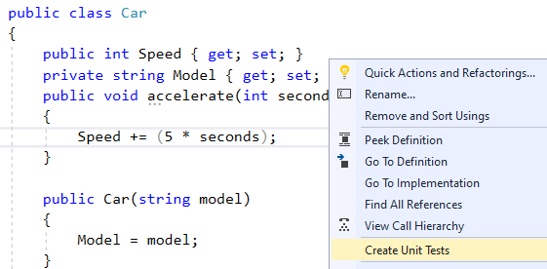
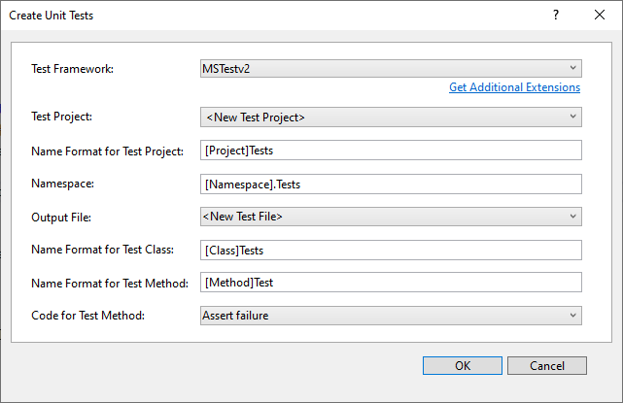
Create a MS-Test project
Right-click on a method and then create a unit test project

Slide 27
Write test code
[TestClass()]
public class CarTests {
Car car;
[TestInitialize]
public void SetUp() {
car = new Car("Ford");
}
[TestCleanup]
public void TearDown() {
car = null;
}
[TestMethod()]
public void accelerateTest() {
car.accelerate(10);
Assert.AreEqual(50, car.Speed);
}
}

Slide 28
In this chapter you revised the topics of the Fundamentals course
Any questions?
Summary

Slide 29
THANK YOU
Hope you enjoyed this learning journey.

